Slide 1
Alternating Current and Voltages Sinusoidal Waves
HANSABA COLLEGE OF ENGINEERING AND TECHNOLOGY, SIDHPUR (098)
INSTITUTE GUIDE
VIKI S PATEL
ELE DEPT. HCET SIDHPUR
Branch :- Mechanical (B23)
Prajapati Mehul C. (130980119085)
Maheshwari Jigar J. (130980119041)
Maheshwari Kailash M. (130980119042)
Jafari Kamaranhusain M.(130980119032)

Slide 2
Objective of Lecture
Discuss the characteristics of a sinusoidal wave.
Define the mathematical relationship between the period, frequency, and angular frequency of a sine wave.
Explain how to define the amplitude of a sine wave.
Describe what a phase angle is and the difference between lagging and leading signals.

Slide 3
Characteristics of a Sine Wave
The length of time it takes to complete one cycle or conversely the number of cycles that occur in one second.
Period
Frequency
Angular Frequency
The maximum and minimum voltage or current swing
Amplitude
Peak-to-peak amplitude
Value of the root mean square (RMS)
Average value of a sine wave
DC offset
Comparison between two sine waves
Phase angle
Lagging and leading signals

Slide 4
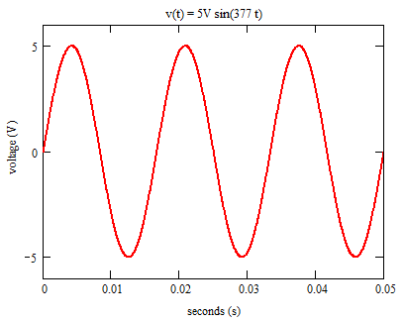

Slide 5
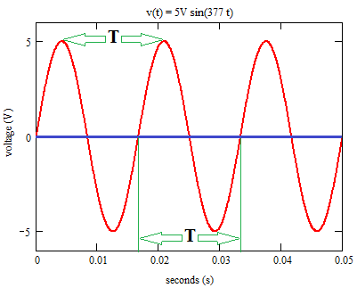
Period, T
The time that it takes for a sine wave to complete one full cycle. This can be measured by finding the times at which the signal crosses zero (need two zero crossings). The unit usually used is seconds (s).
An alternative way to measure the period is to determine the time required for the sine wave return to the same maximum or minimum value.
t₁ t₂

Slide 6
Frequency, f
The number of cycles a sine wave will complete in one second(fractions are okay). The unit is cycles/second or Hertz (Hz).
The longer the period, the lower the frequency is.
The shorter the period, the higher the frequency is.

Slide 7
Electric Utilities
Standardization on the frequency of the electricity distribution systems didn’t occur until the mid-1900’s.
The frequency of the ac voltage supplied by power companies in the US is 60 Hz.
The frequency used in much of Europe and Asia is 50 Hz.
While some electronic circuits function properly when connected to a power supply operating at either frequency, some are designed for a specific frequency, which is one reason why power adaptors are needed when you travel.

Slide 8
Angular frequency
Motors are used in the alternators in coal- and gas-powered electric generation stations. One full rotation of the motor shaft produces one complete cycle of the ac electricity produced.
Position of the motor shaft is measured in radians (rad) or degrees (º).
1 rad = 57.3º
2p rad = 360º

Slide 9
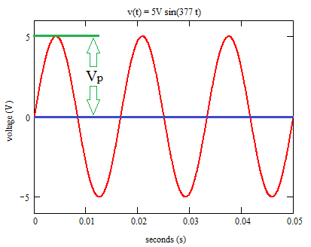
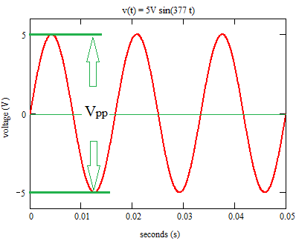
Amplitude
Peak amplitude
Peak-to-Peak amplitude

Slide 10
Instantaneous Value
Instantaneous value or amplitude is the magnitude of the sinusoid at a point in time.

Slide 11
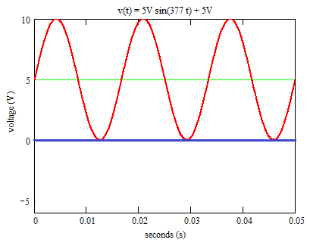
Average Value
The average value of a sinusoid signal is the integral of the sine wave over one full cycle. This is always equal to zero.
If the average of an ac signal is not zero, then there is a dc component known as a DC offset.

Slide 12
Root Mean Square (RMS)
Most equipment that measure the amplitude of a sinusoidal signal displays the results as a root mean square value. This is signified by the unit Vac or V_{RMS}.
RMS voltage and current are used to calculate the average power associated with the voltage or current signal in one cycle.

Slide 13
Phase Angle
The phase angle is an angular measurement of the position of one sinusoid signal with respect to a reference.
The signal and reference must have the same frequency.

Slide 14
Calculation of Phase
Suppose there are three signals
One signal is the reference
I have chosen the reference to be the signal in blue on the following slide
The phase of the other two signals will be calculated with respect to the reference signal.
The period of each signal should be the same, which means that all signals have the same frequency.

Slide 15
Voltage (V)
Time (seconds)

Slide 16
Example #1
Calculate the period, T, for the reference signal
This is the time for a full cycle to be completed.
T= 500 second for Signal 1
Calculate the difference in time between zero crossings of
Signal 2 and Signal 1: Dt = 40 second – 0 seconds = 40 s
Signal 3 and Signal 1: Dt = 480 seconds – 0 seconds= 480 s

Slide 17
Example #1 (con’t)
The sinusoidal function that describes Signal 1, the reference voltage, is
V(t) = 5V sin (wt) where w = 2p/T = 12.6 mrad/s
To write the sinusoidal function that describes Signals 2 and 3, we need to address the fact that there is a shift in the zero crossings
V(t) = A sin (wt + f) where w = 2p/T
f = -2p Dt/T in radians or f = -360º Dt/T
f is called the phase shift

Slide 18
Lagging and Leading
Don’t get fooled by the positions of the curves on the graph!
Signal 2: V(t) = 5V sin [(12.6 mrad/s)t – 28.8º]
f is -0.502 radians or -28.8 degrees
Signal 2 lags Signal 1 as it reaches zero at a later time than Signal 1
Signal 3: V(t) = 5V sin [(12.6 mrad/s)t + 14.4º]
f is 0.251 radians or 14.4 degrees
Signal 3 leads Signal 1 as it reaches zero at an earlier time than Signal 1

Slide 19
Writing Formulas
where f is in degrees and the units for w are usually not included.

Slide 20
Summary
AC signals are sinusoidal functions.
The mathematical description of the sinusoid includes the peak amplitude and the angular frequency and may include a phase angle.
RMS values of a sinusoid are calculated using the formula
Phase angle for a sinusoid is calculated with respect to a reference.
A signal lags a reference when f_{signal} – f_{reference} < 0º.
It leads a reference when f_{signal} – f_{reference} > 0º.

Slide 21
THANK YOU

